Slide 1

14
Monkeypox Detection
TEAM :
2103A52137 G. Sri Harshini
2103A52147 K. Ajay Rao
2103A52159 Md. Naveed Sharief
Mentor and Trainer :
Mr. D. Ramesh
Assistant Professor
CS and AI&ML

Slide 2
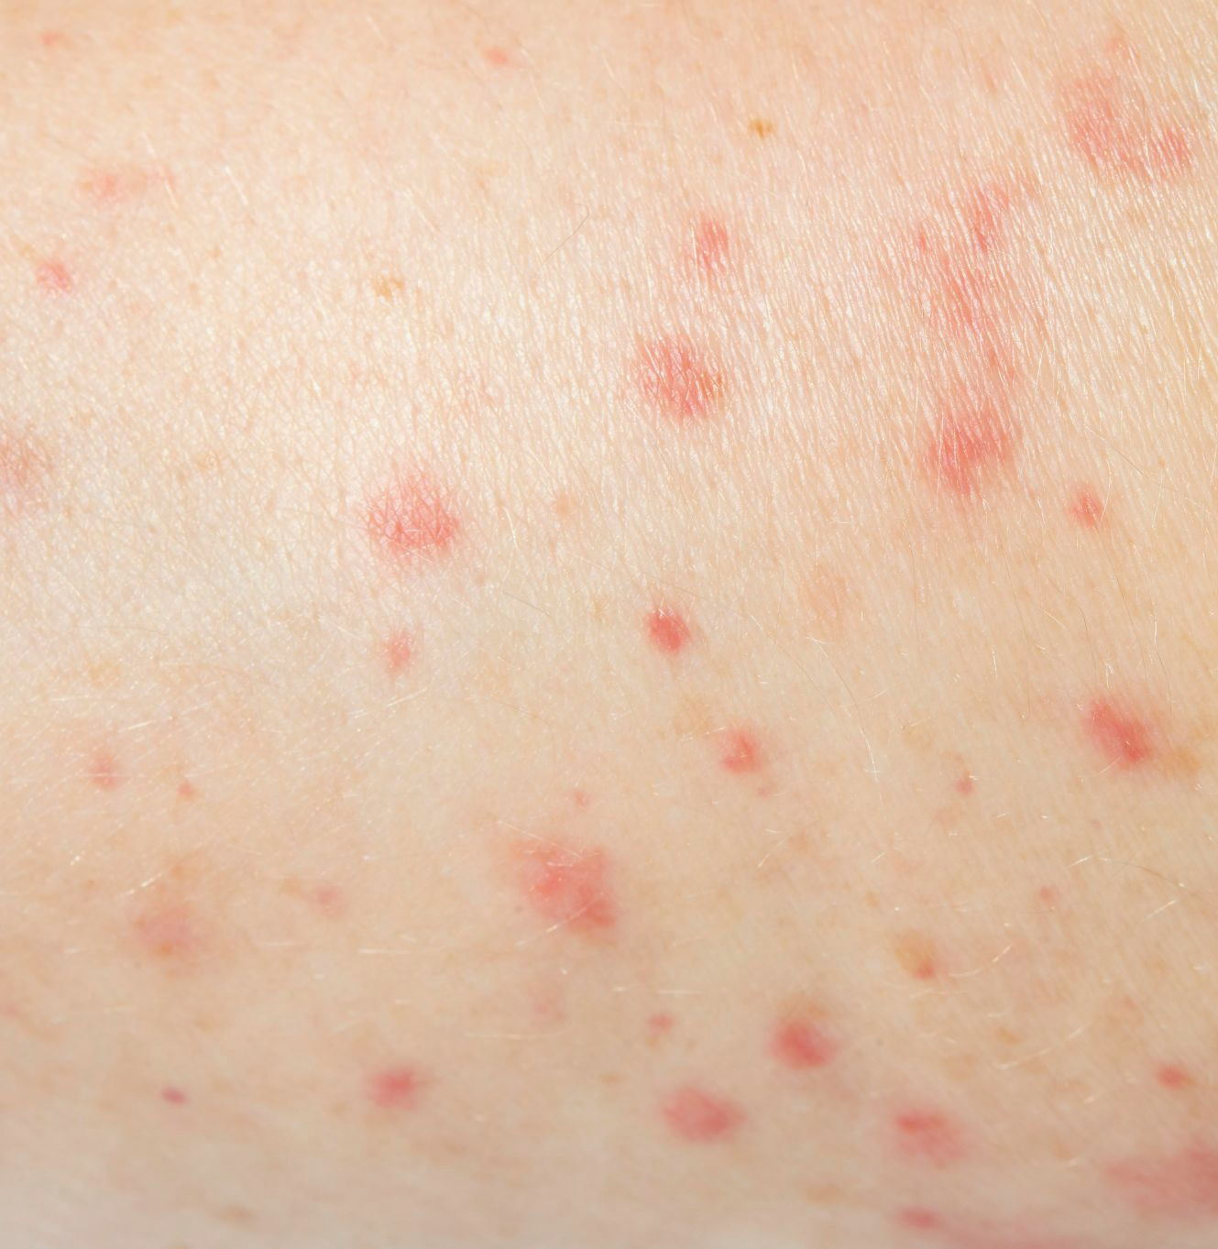
Introduction
Monkeypox is a zoonotic disease that was first discovered in monkeys in 1958.
The virus is similar to the one that causes smallpox, and it can cause a range of symptoms in humans, including fever, headache, muscle aches, and a rash. In severe cases, monkeypox can be fatal.
The disease is most commonly found in Central and West Africa, but it has also been reported in other parts of the world.

Slide 3
Problem Statement
Monkeypox can be difficult to diagnose because its symptoms are similar to other diseases such as chickenpox and measles.
Therefore, a reliable and accurate diagnostic method is needed to detect monkeypox early and prevent its spread.

Slide 4
Existing System
Diagnosis of monkeypox currently involves laboratory tests that detect the presence of the virus in patient samples, along with clinical evaluation and epidemiological investigation.
However, these tests can take longer to provide results, leading to delayed treatment.

Slide 5
Proposed System
Developing a machine learning model that can predict monkeypox based on images of rashes and lesions.
By identifying patterns and features that are characteristic of the disease, this model can speed up the diagnostic process and improve the accuracy of diagnoses, ultimately leading to earlier treatment and better outcomes.

Slide 6
Objectives
To develop a machine learning model to classify skin lesions caused by monkeypox.
To evaluate the performance of the model and compare it with other classification methods.
To detect monkeypox at an early stage.

Slide 7
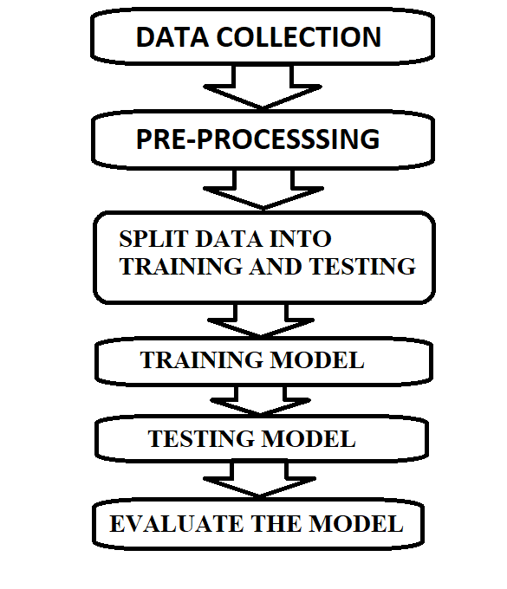
Architecture
Steps in making of a ML model

Slide 8
Analysis of the survey
We are surveyed the many scholars from 2017 to 2021,they had done with different models and got accuracy based on their methodology.
S.NO | YEAR | METHOD | ACCURACY SCORE
1 | 2020 | Random Forest | 92.8%
2 | 2020 | CNN | 91.5%
3 | 2021 | XG Boost | 91.4%
4 | 2019 | MLP Neural Network | 87.8%
5 | 2021 | SVM | 88.7%
6 | 2017 | Logistic Regression | 84.4%
7 | 2020 | Naive Bayes | 79.6%
8 | 2020 | Decision Tree | 81.2%
9 | 2020 | K-Nearest Neighour | 80.9%
10 | 2021 | Gaussian Naive Bayes | 81.3%

Slide 9
Dataset Description
The Dataset is collected from Kaggle, "Monkeypox Skin Lesion Dataset (MSLD)" which was created by collecting and processing images from different means of web-scrapping i.e., from news portals, websites and publicly accessible case reports.
The dataset we used has on whole 3192 images. These images are classified into 2 classes Monkey_pox(M) and Others(NM). The 'Others' class represents non-monkeypox (chickenpox and measles) cases.
Monkey_pox class has 1428 images and the Others class has 1764 images. All the images are resized into 224x224 pixels so that they can be readily used with many pre-trained deep learning models.

Slide 10
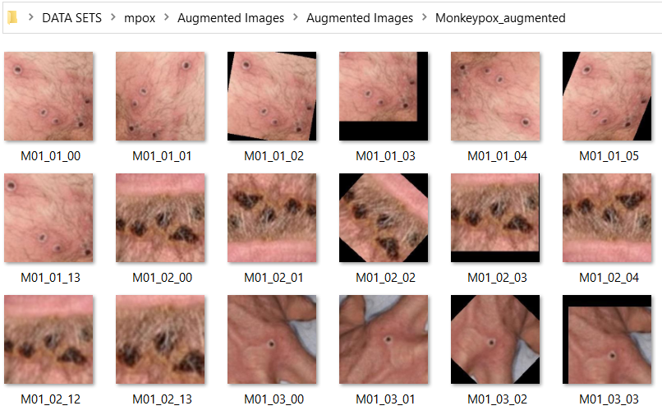
Dataset
Monkey Pox

Slide 11
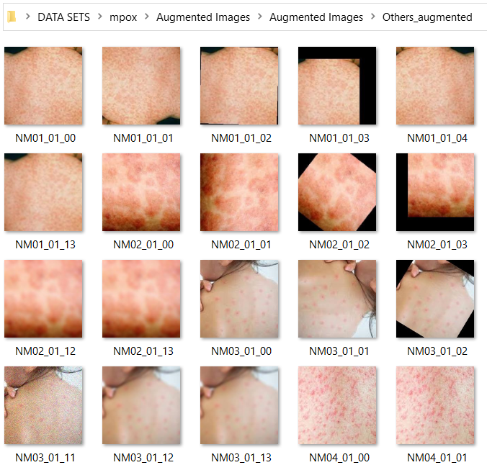
Dataset
Others

Slide 12
Data Pre-Processing
Pre-processing techniques are essential in image processing and computer vision tasks to enhance the quality of the input images and make them more suitable for analysis by machine learning algorithms. We used pre-processing techniques image resizing, grey scaling, and flattening.
Image Resizing:
Image resizing is the process of changing the size of an image while maintaining its aspect ratio. It is often used to make the input images compatible with the requirements of the machine learning algorithms. Here we used, the code "img = cv2.resize(img,img_size)" resizes the input image to the specified size.

Slide 13
Data Pre-Processing
Grey Scaling:-
Grey scaling is a technique that converts an RGB image into a grayscale image. This is achieved by taking the weighted average of the red, green, and blue channels of the image. The resulting image has only one channel, which reduces the complexity of the image and makes it easier to process. Here we used, the code "img_gray = cv2.cvtColor(img, cv2.COLOR_BGR2GRAY)" converts the input image to grayscale using the OpenCV library.

Slide 14
Data Pre-Processing
Flattening:
Flattening is a technique that converts a two-dimensional image into a one-dimensional array. This is achieved by concatenating the rows of the image into a single row. The resulting array can be used as input for machine learning algorithms that require one-dimensional input. Here we used, the code "img_flatten = img_gray.flatten()" which flattens the previously grayscale image into a one-dimensional array.

Slide 15
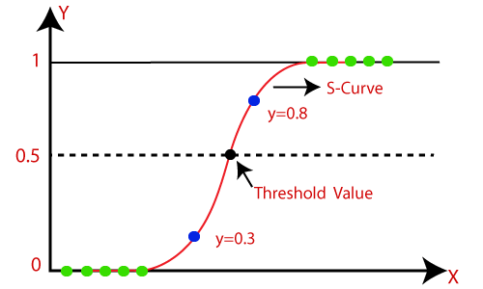
Methodology
Using Logistic Regression:
Logistic regression uses the concept of predictive modeling as regression; therefore, it is called logistic regression, but is used to classify samples; Therefore, it falls under the classification algorithm.
Sigmoid function removes the effect of outlier and makes the output between 0 to 1.
z=B0+(B1)(x1)+(B2)(x2).....(Bn)(xn)
f(x)= 1/(1+ e^z)

Slide 16
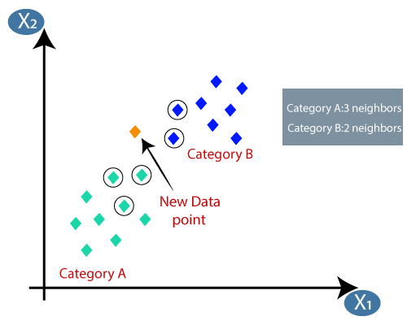
Methodology
Using KNN:
Select the number K of the neighbors.
Calculate the Euclidean distance of K number of neighbors.
Take the K nearest neighbors as per the calculated Euclidean distance.
Among these k neighbors, count the number of the data points in each category.
Assign the new data points to that category for which
the number of the neighbor is maximum.
Our model is ready.

Slide 17

Methodology
Using Decision Tree:
Begin the tree with the root node, says S, which contains the complete dataset.
Find the best attribute in the dataset using Attribute Selection Measure (ASM).
Divide the S into subsets that contains possible values for the best attributes.
Generate the decision tree node, which contains the best attribute.
Recursively make new decision trees using the
subsets of the dataset created in step 3. Continue
this process until a stage is reached where you
cannot further classify the nodes and called the
final node as a leaf node.

Slide 18
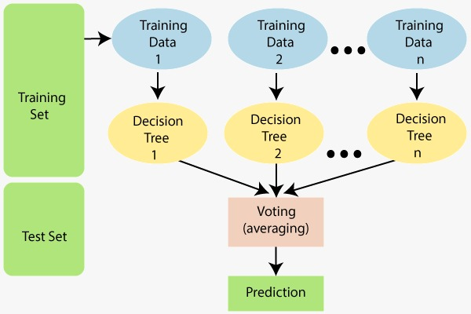
Methodology
Using Random Forest:
Select random K data points from the training set.
Build the decision trees associated with the selected data points (Subsets).
Choose the number N for decision trees that you want to build.
Repeat Step 1 & 2. For new data points, find
the predictions of each decision tree, and assign
the new data points to the category that wins the
majority votes.

Slide 19
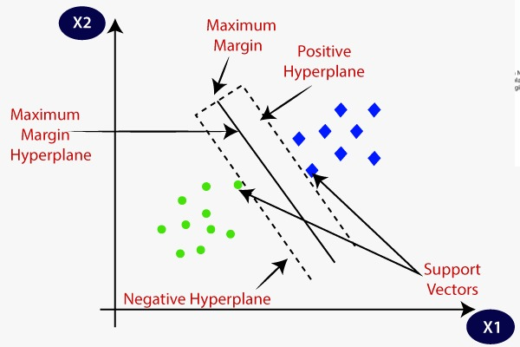
Methodology
Using SVM:
Support Vector Machine or SVM is one of the most popular Supervised Learning algorithms, which is used for Classification as well as Regression problems.
The goal of the SVM algorithm is to create the best line or decision boundary that can segregate n-dimensional space into classes so that we can easily put the new data point in the correct category in the future.
This best decision boundary is called a hyperplane.
This best boundary is known as the hyperplane
of SVM.
SVM chooses the extreme points/vectors that help
in creating the hyperplane.
These extreme cases are called as support vectors,
and hence algorithm is termed as Support Vector Machine.

Slide 20
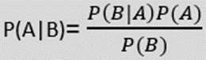
Methodology
Using Naive Bayes:
Naive Bayes algorithm is a supervised learning algorithm, which is based on Bayes theorem and used for solving classification problems.
It is mainly used in text classification that includes a high-dimensional training dataset.
Naive Bayes Classifier is one of the simple and most effective Classification algorithms which helps in building the fast machine learning models that can make quick predictions.
It is a probabilistic classifier, which means it predicts on the basis of the probability of an object. P(A|B) is Posterior probability
P(B|A) is Likelihood probability
Formula:

Slide 21
Results
Accuracy Comparison FROM DIFFERENT MODELS
ML model | Accuracy
KNN | 0.8450704225352113
LOGISTIC REGRESSION | 0.837245696400626
DECISION TREE | 0.6948356807511737
RANDOM FOREST | 0.8544600938967136
SVM | 0.8247261345852895
NAÏVE BAYES | 0.6604068857589984

Slide 22
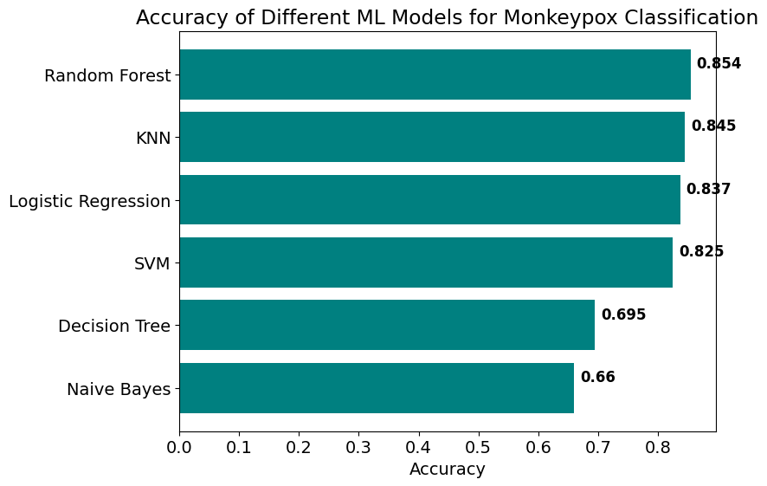
Results

Slide 23
Conclusion
Finally, after performing all the steps needed to get the results from preparation to preprocessing to performing the models (Logistic regression, KNN, Decision Tree, Random Forest, SVM and Naïve Bayes) we conclude that the Random Forest model with 85.44600938967136 percent accuracy performs slightly better than KNN of 84.50704225352113 percent accuracy.

Slide 24
Future Scope
In order to further improve the accuracy of the classification model for monkey pox detection, deep learning techniques such as convolutional neural networks (CNN) and recurrent neural networks (RNN) can be explored. Additionally, transfer learning approaches can be leveraged to improve feature extraction and classification accuracy. Incorporating additional data sources such as patient demographics and symptoms can also enhance the accuracy of the model and aid in early detection and treatment of the disease.

Slide 25
THANK YOU

